Slide 1

VR(Virtual Reality)- Bot

Slide 2
Introduction to the BOT
Virtual reality is a computer-generated simulation of a three-dimensional image or environment that can be interacted with in a seemingly real or physical way by a person using special electronic equipment, such as a helmet with a screen inside or gloves fitted with sensors.
The concept of virtual presence is the goal of the bot. Places with harsh conditions such as extreme heat or cold are the ones humans strive to explore but incapable of doing so due to the conditions. This is where VR bots can help develop a virtual environment with same surroundings but with comfort of home.

Slide 3
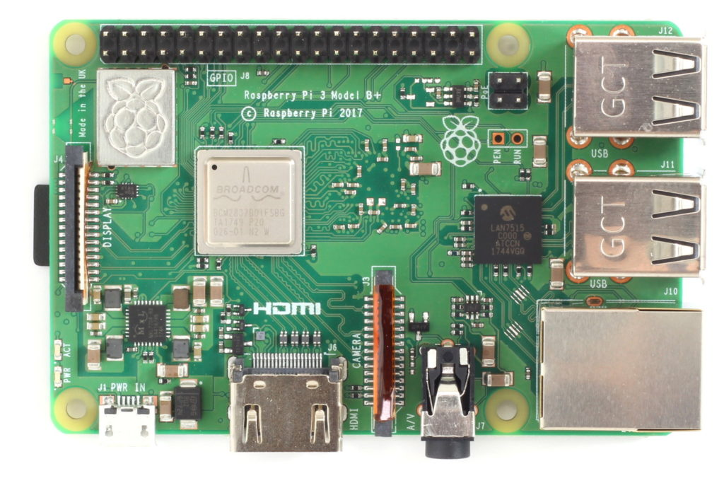
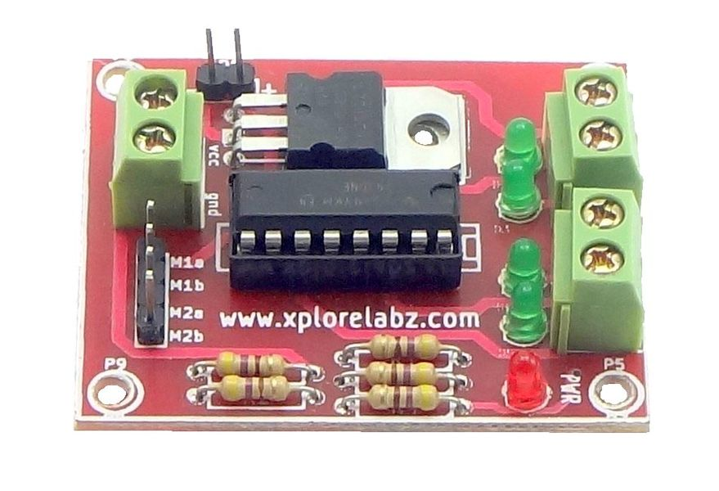
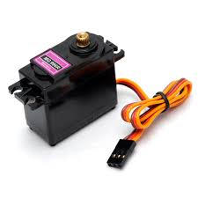
Components for the project
RPI 3B+ Module
L293D Motor driver
Tower Pro 996R
It will be used to used to control the servo motors according to the gyro data from the user’s headset phone. It will also be used to stream the rpi camera data to the headset.
Motor require high amount of current whereas the controller circuit works on low current signals. So the function of motor drivers is to take a low-current control signal and then turn it into a higher-current signal that can drive a motor.
A servomotor is a rotary actuator or linear actuator that allows for precise control of angular or linear position, velocity and acceleration. It consists of a suitable motor coupled to a sensor for position feedback

Slide 4
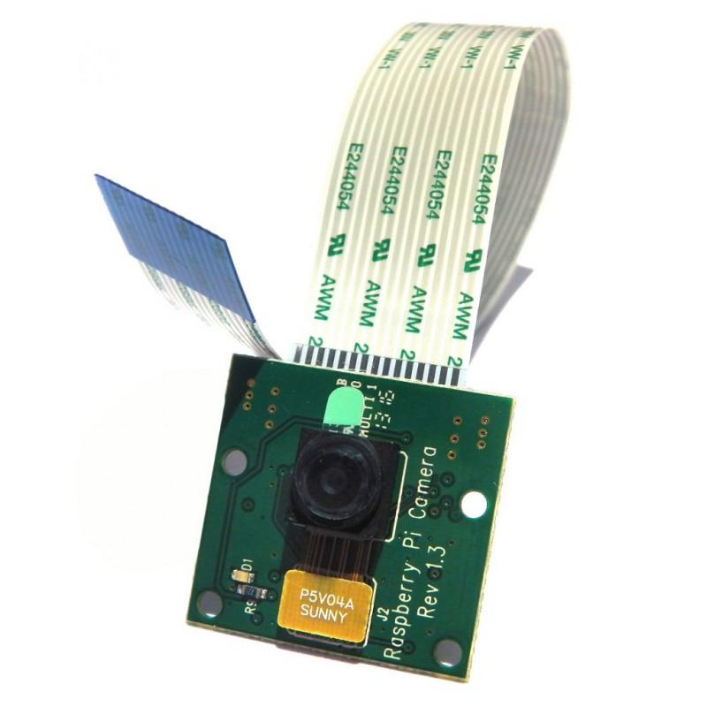
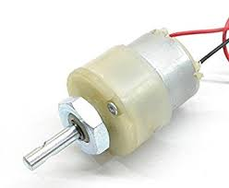
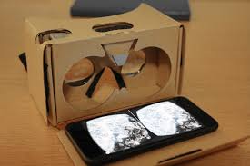
Components for the project
RPI 5MP camera module
Geared Motor 12v/500rpm
Basic VR headset and Phone
This will be used to take the video of wherever the bot is deployed and the data will be sent to the user’s headset through the rpi module
Used to turn move the bot according to the user’s instruction
Basic VR headset required for best experience of the surrounding. Any smartphone with VR capabilities will work fine to stream the data captured by the bot

Slide 5
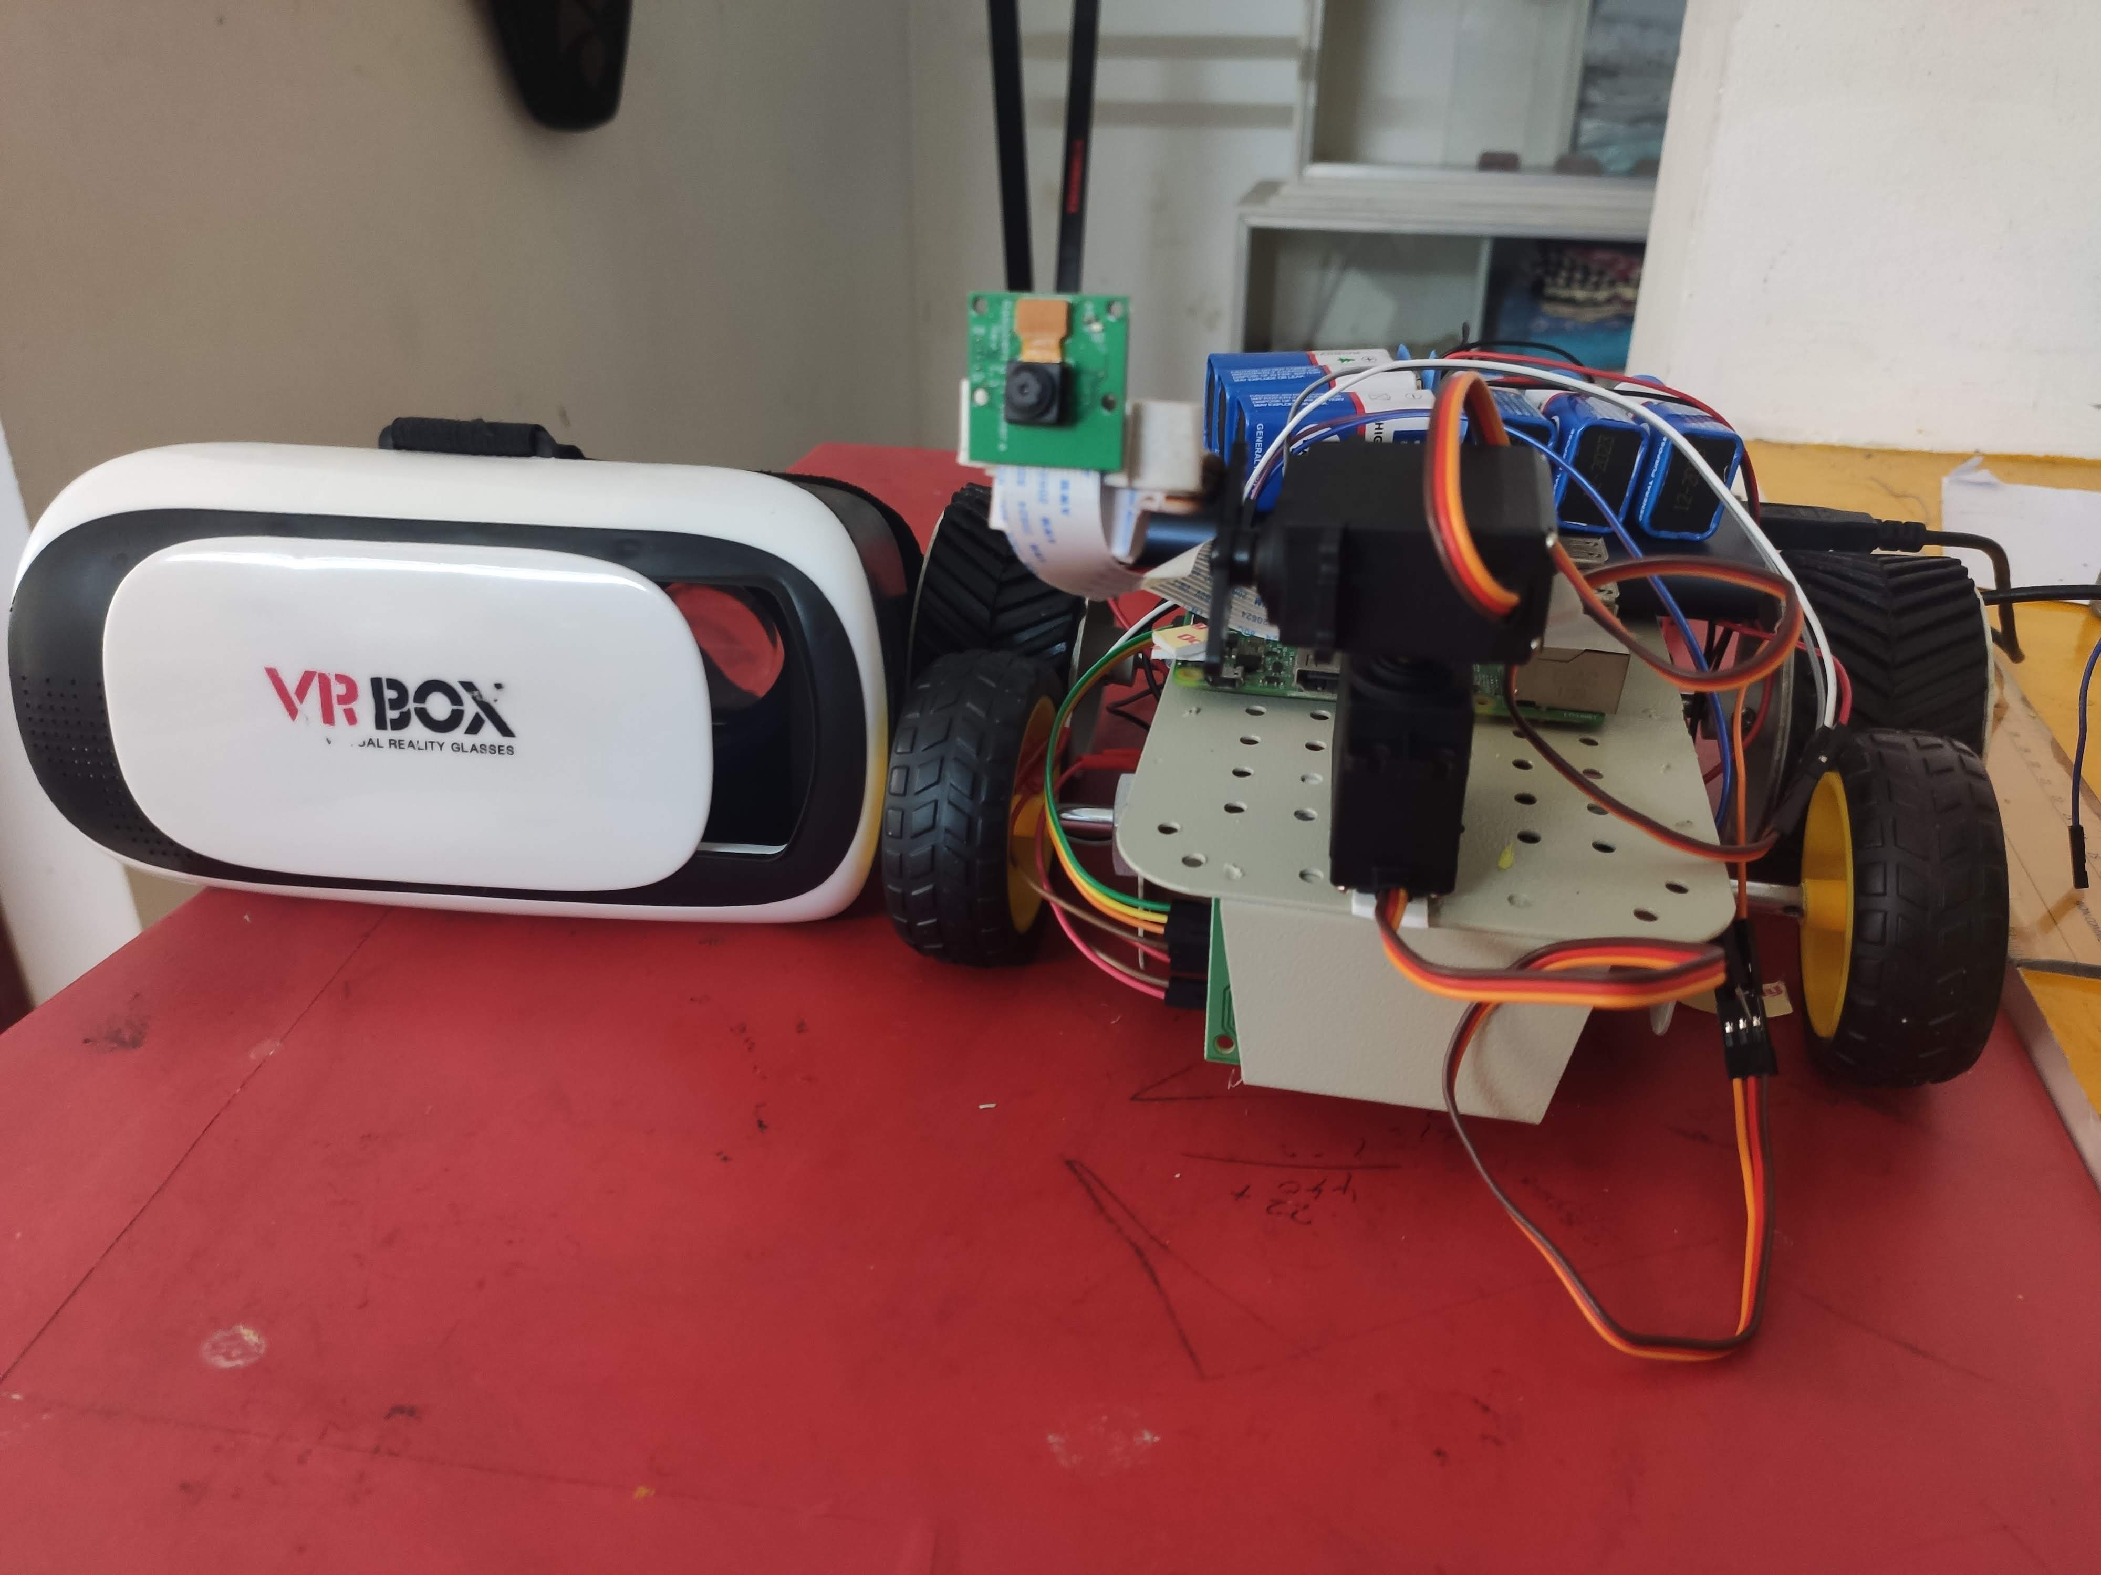
Flow of the working of bot
RPI Script
RPI would host a video to the server which is hosted through the RPI on the local network and the phone access this server if its in the local network
Socket Script
This part will allow us to get the gyro data from the phone using a socket connection which will then be used to control the tilt of the bot according to user’s tilt
Controller Script
This part controls the bot for example forward or backwards depending on the user who can see the surrounding.

Slide 6
The Streaming
Using the UV4L platform
Custom website to output the vr
Video streaming with minimum latency

Slide 7
The Movement controls
Taking keyboard input from remote Rpi terminal
Realtime input taken with curses library
Motors on the chassis controlled with the Rpi GPIO pins using L293D driver
External power supply for motors

Slide 8
Pan – Tilt Camera
Phones gyro data is taken from Wireless IMU
Python Socket script to get the data from the phone
Get the accelerometer and gyroscope data and convert them to different angles
Using the RPi GPIO pins control the 2 servos for pan and tilt

Slide 9
